Slide 1

Men vs. Women
Who rules the sky (and beyond) when it comes to NASA hiring rates?
Kaity Tainer, Cynthia Cardenas, Elesha Hunter, Kendra Sawyer, Rachael Reich, Stacey Gonzalez

Slide 2


Rachael Reich
BS Mechanical Engineering (Drexel University, 2017)
Rachael is from NJ
After three years in the Semiconductor industry, she transitioned to Data Science.

Slide 3

Cynthia Cardenas
BA Elementary Education (University of South Florida)
Currently employed: First-grade teacher

Slide 4

Elesha Hunter
Elesha is from Michigan
Currently employed: Marketing Coordinator (San Antonio, TX)

Slide 5

Kendra Sawyer
BS Music Education (Elizabeth City State University)
Currently employed: Elementary Music Teacher

Slide 6

Stacey Gonzalez
BA Political Science
BS Sociology
MS Psychology MPH Public Health and Epidemiology
Phd International Psychology
Massive Incident Reaction Team certification from Homeland Security
Retired Commander of the United States Army Air Defense Artillery Certified Officer of the Philadelphia Police Department and Critical Incident and Trauma certification.
NCIC / PCIC certification, SQL certification, Bias and Diversity certification from the Anti-Defamation League

Slide 7

Kaity Tainer
BA Psychology (University of Washington, 2016)
USPA Member (2016)
Currently Employed: Electrician (Tacoma, WA)
Commercial/Residential
Past employment: Executive Assistant (Los Angeles, CA)
Desilu-Studios (created Star Trek franchise) and Bruce Brown Films (The Endless Summer)

Slide 8
Background
President Eisenhower suggested NASA chose from military test pilots
Also proposed NASA to congress
1959-1980: 65% came from the military
Overall less women in the military
Conversations about diversity in the workplace led us to more questions

Slide 9
Background
The 70’s: a springboard for women in astronomy
1977: recruitment of NASA skyrocketed because of Nichelle Nichols's help.
Role as Lieutenant Uhura on Star Trek inspired young girls to become astronauts at NASA
Also played a role recruiting people of color
Received astronaut training and spoke to colleges about the importance of NASA
Uhura translation (Swahili): “Freedom”

Slide 10
Methods
Data was gathered from the NASA website
•Data includes information on 714,193 astronauts. (sample size)
Wrangle Data
•We took multiple data sets and combined them in order to run our
analysis
•We dropped unnecessary data
•Dropped missing data
•We recoded data from words (int64) to Boolean operators (True/False)
•Square root space walk and space flight (hr) in order for it to meet
the normal distribution assumption for an independent t test

Slide 11
Variables
Age- mean: 38.158317, std: 7.615960, min: 24.5995,
max: 73.5633
•Education- mean- 7.548
•Space Flights- mean: 2.3599
•Space Flights (hr)- mean: 1210.822
•Space Walks- mean: 1.322
•Males Accepted in NASA Program- mean: 60.037
•Females Accepted in NASA Program- mean: 12.444
•Budget

Slide 12
Specific Methods Used:
Python
Independent t-test
Correlation matrix
Linear Regression
Tableau

Slide 13
Evaluation Questions
What is the difference between the hiring rate of males and females that are admitted into the NASA program in the last 10 years?
What is the ratio of males to females that are sent on space missions?

Slide 14
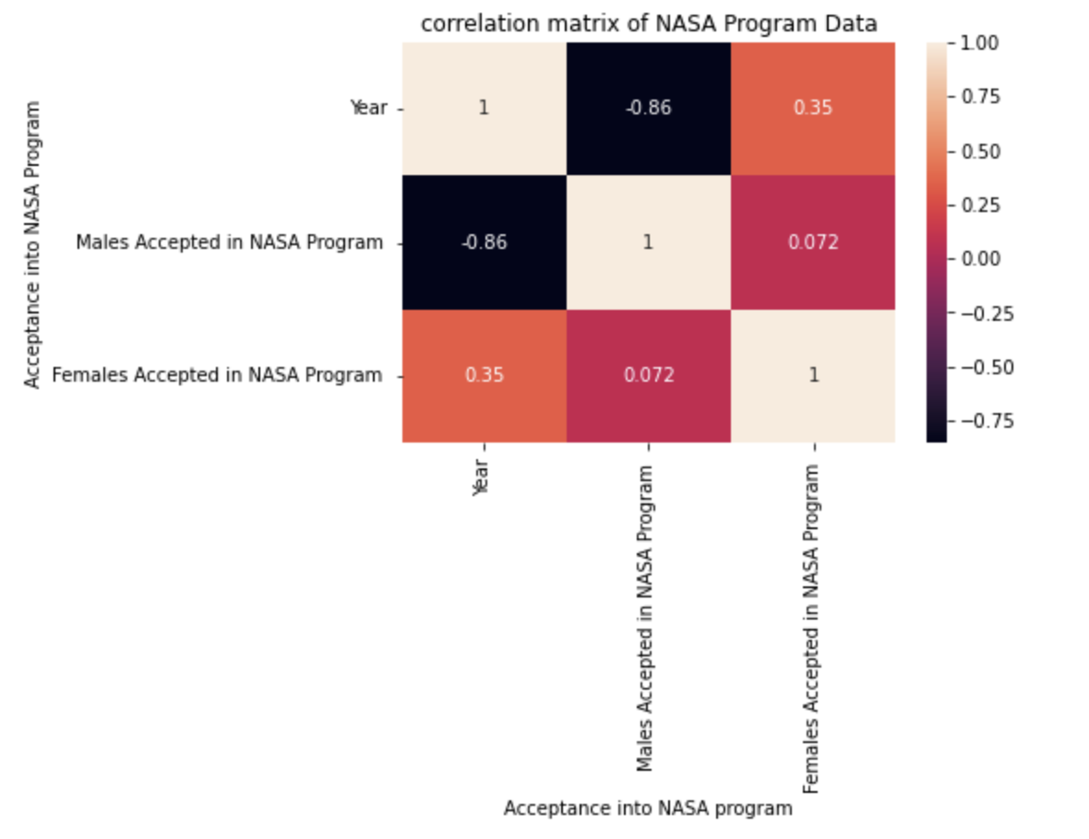
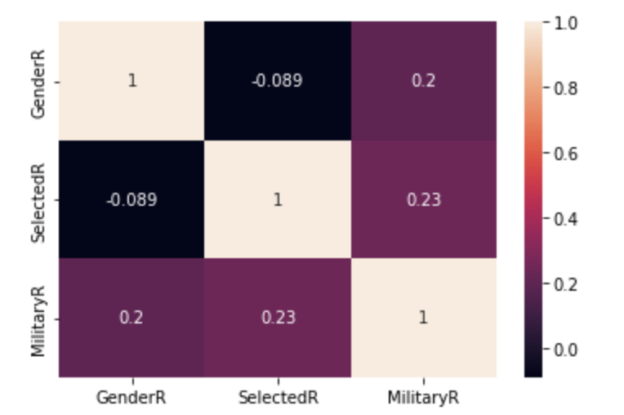
Correlations
heatmap.corr(method='pearson').style.format("{:.2}").background_gradient(cmap=plt.get_cmap('coolwarm'), axis=1)
Notes:
We can see here Military service seems to have a bigger impact than gender on being select4ed. With about a 23% SCHNCE OF BEING Accepted based on prior military service
The other matrix shows more correlations – we can see the biggest correlation is between year and females accepted at .35
Lastly we have budget correltation budget seems to have had a negative impact on hiring
A negative correlation is a relationship between two variables such that as the value of one variable increases, the other decreases.

Slide 15
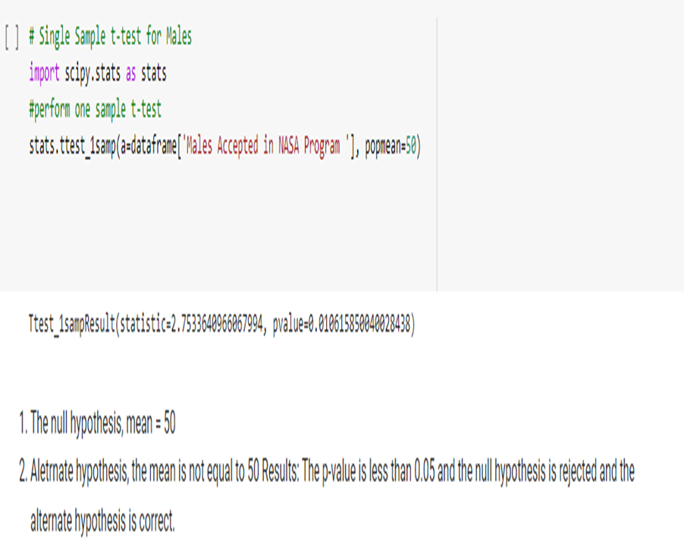
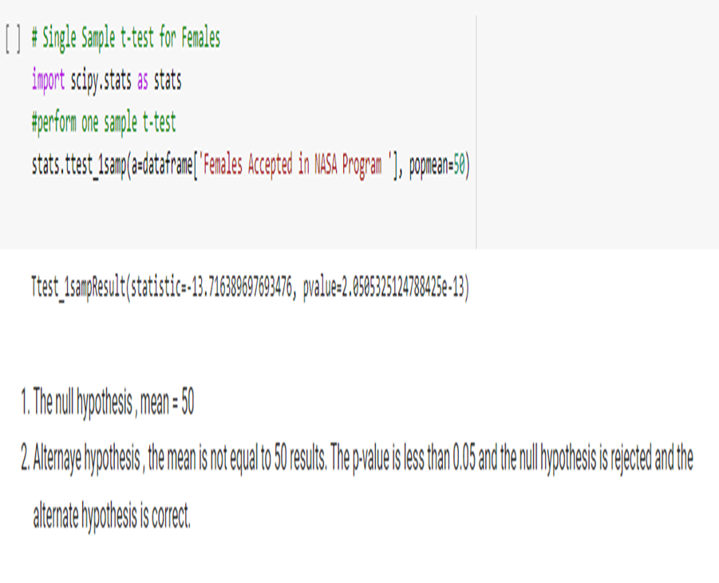
Simple Sample T Test
For males
For females

Slide 16
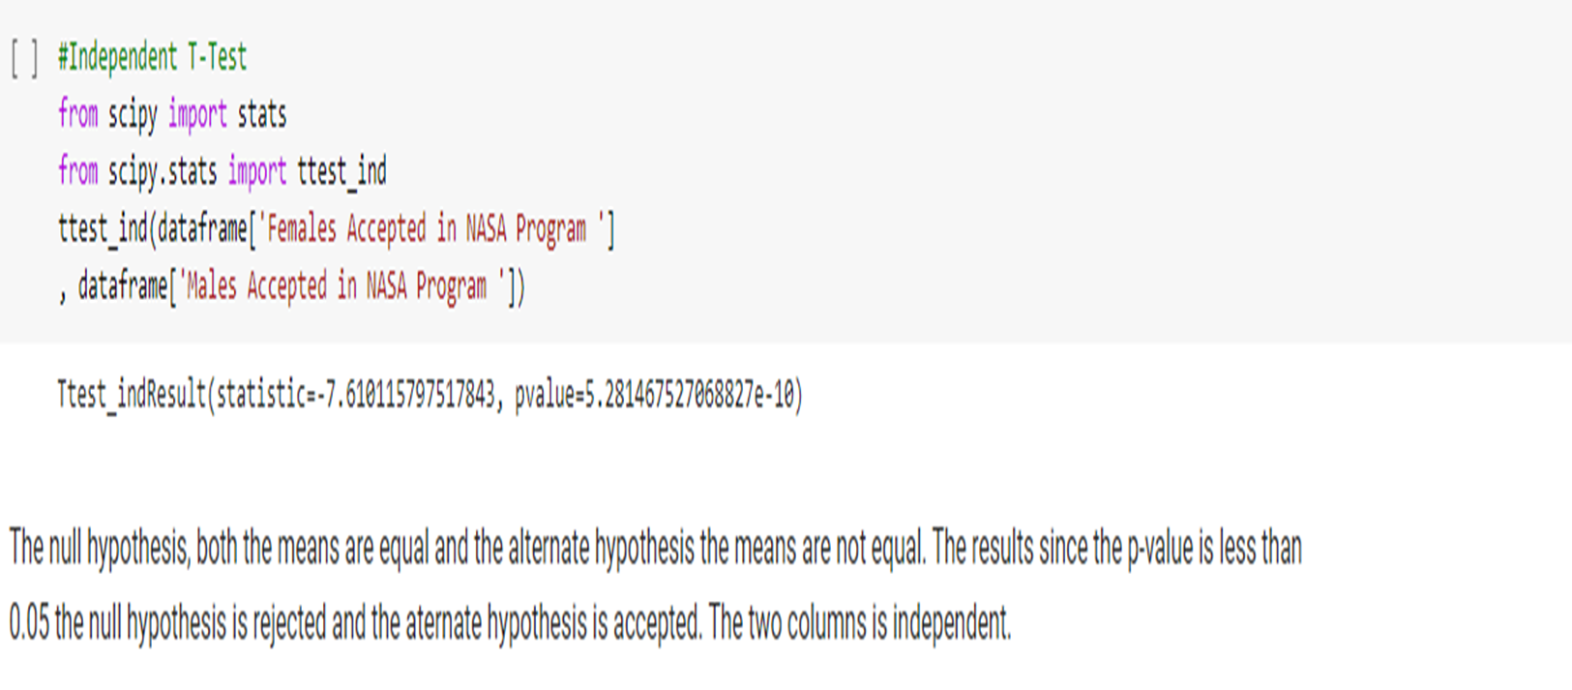
Independent T-test

Slide 17
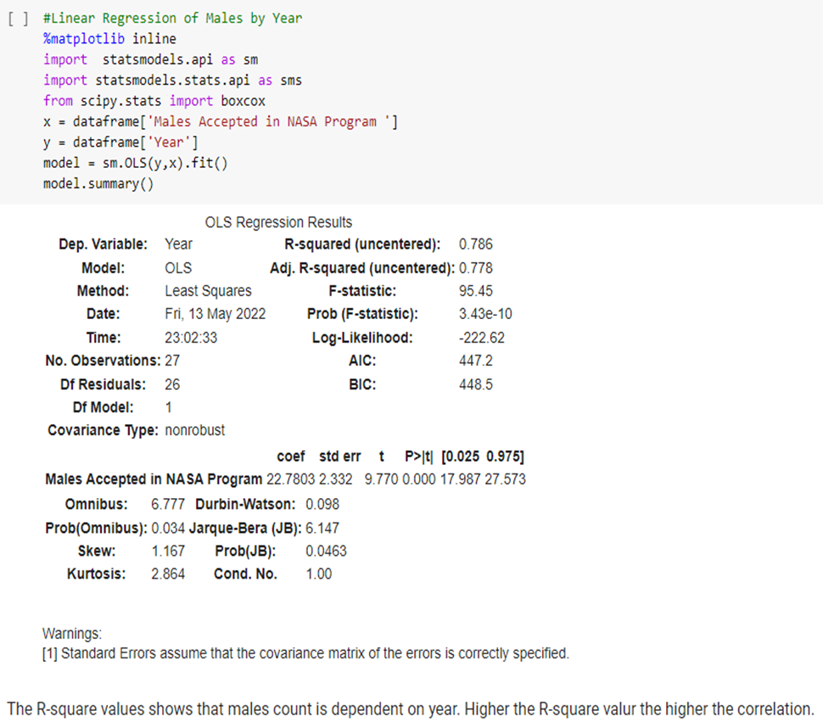
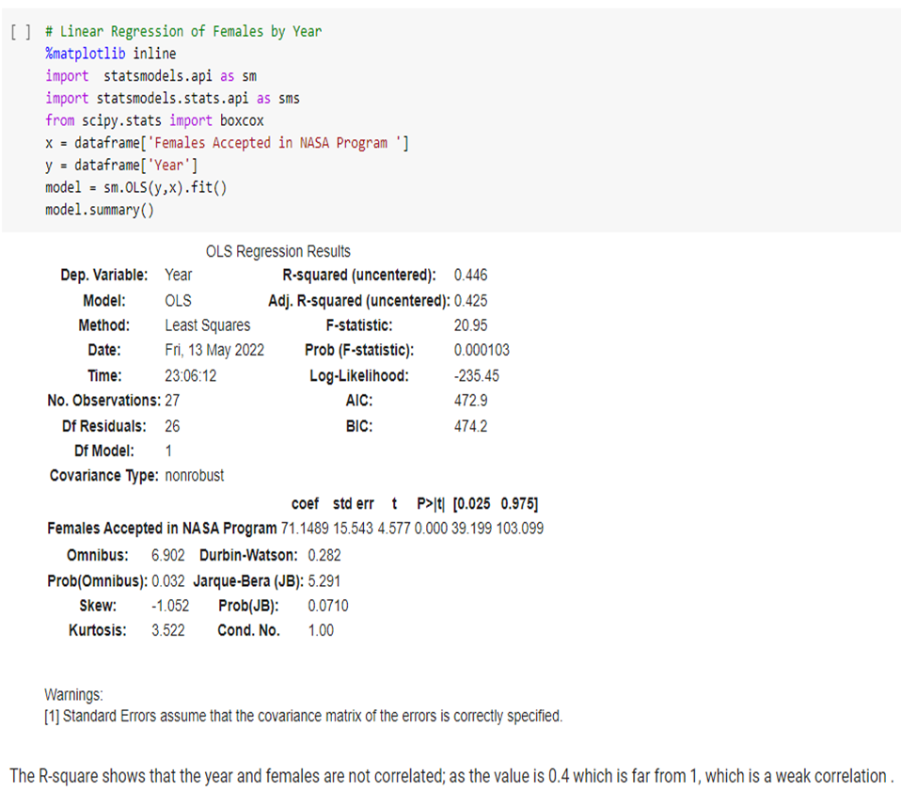
Linear Regression
Males by year
Females by year

Slide 18
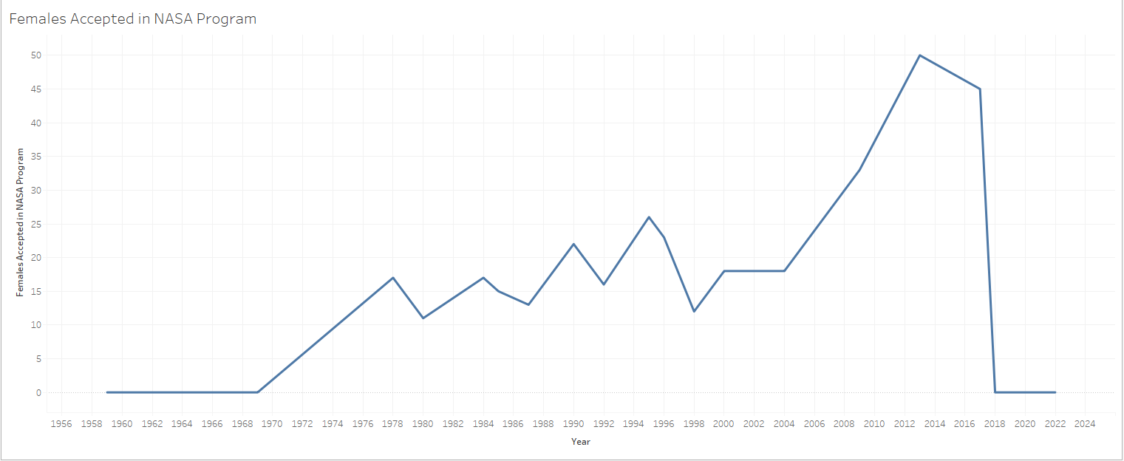
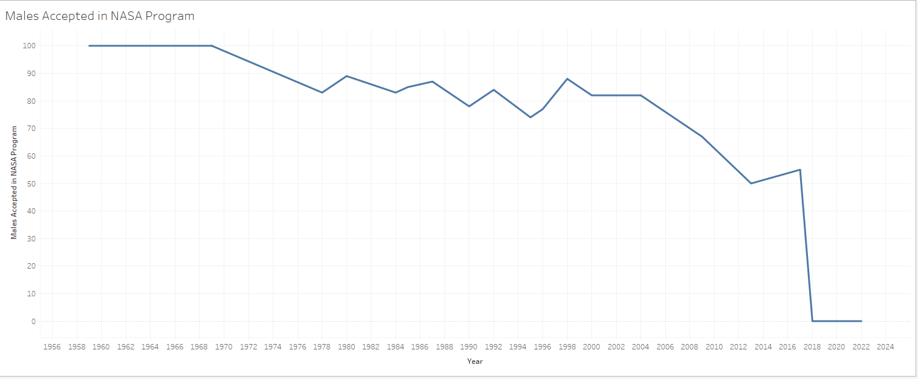

Slide 19
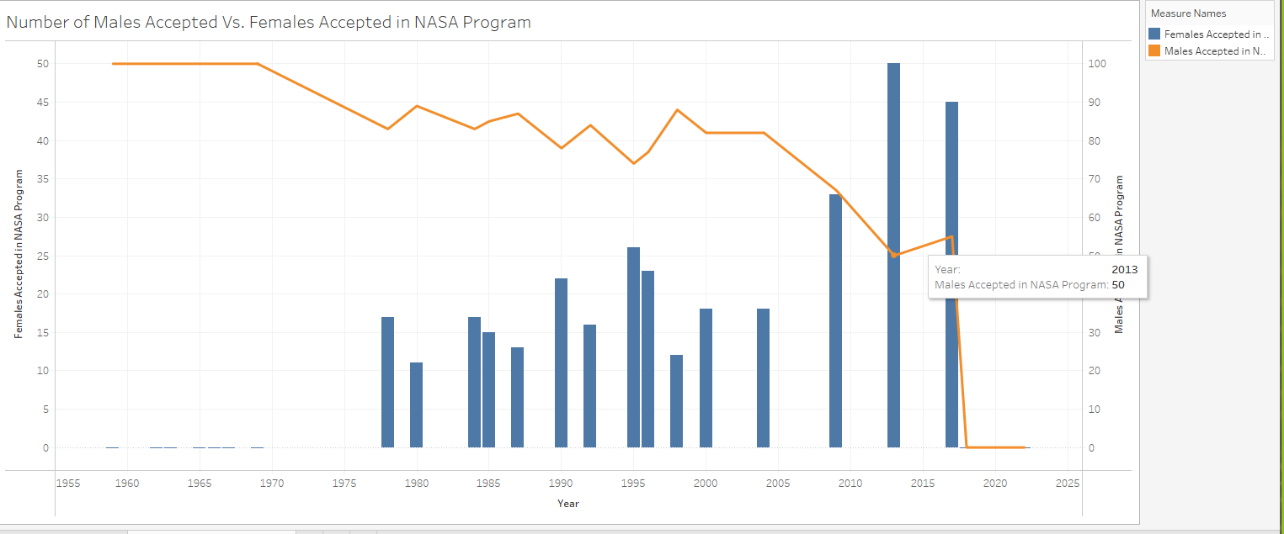

Slide 20
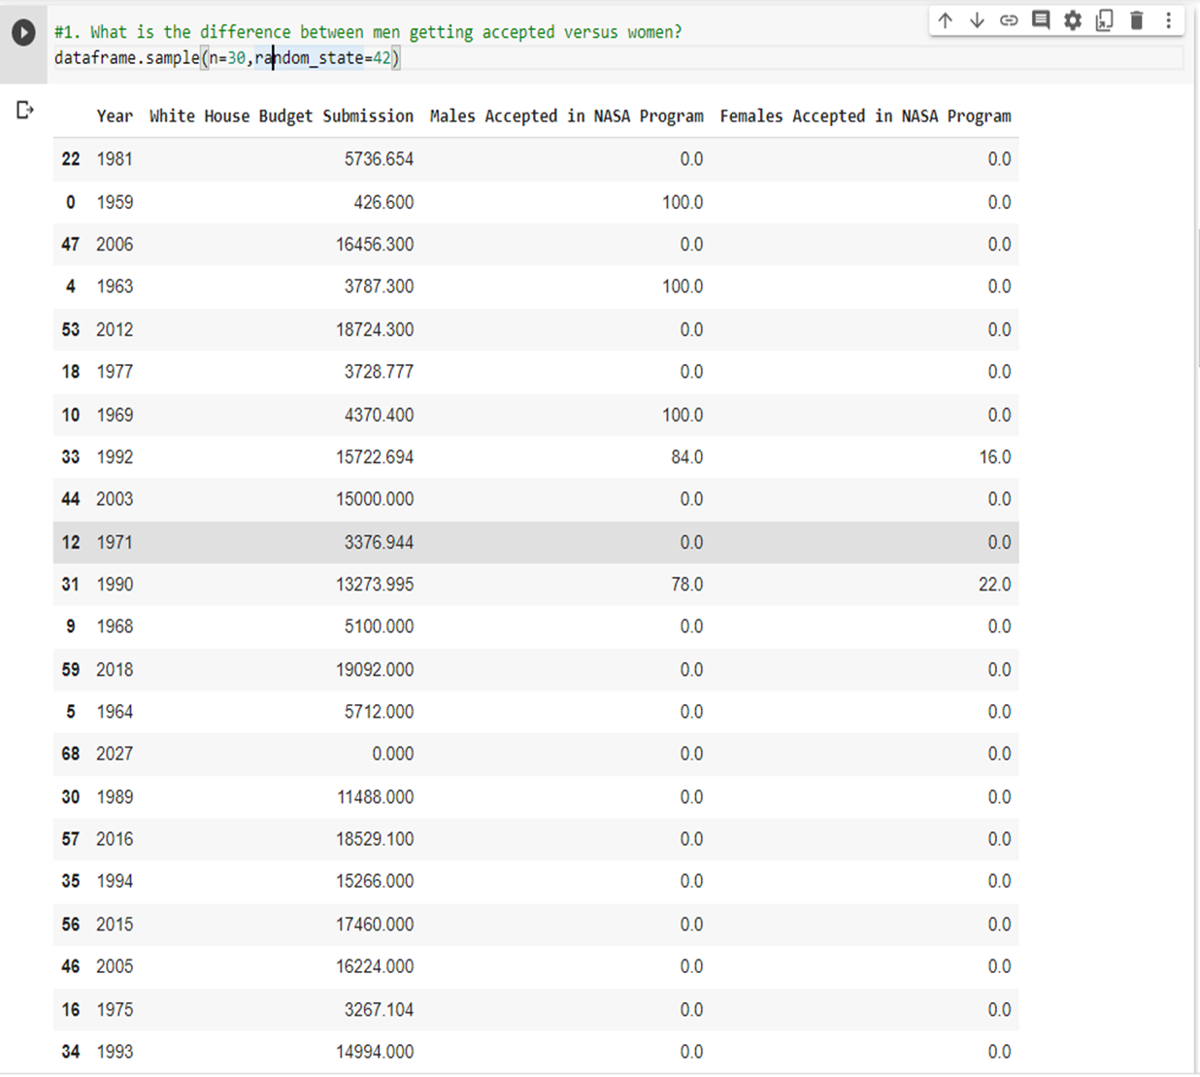
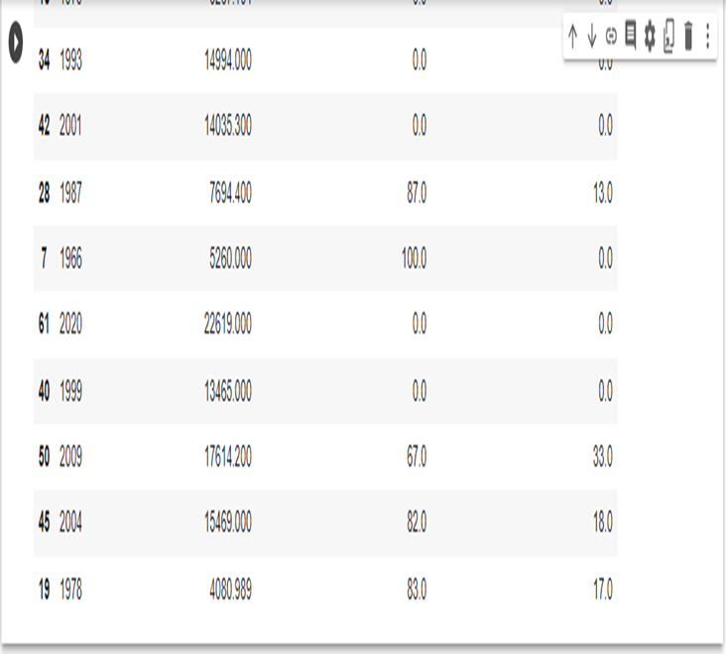
Data Frame of Budget Analysis

Slide 21
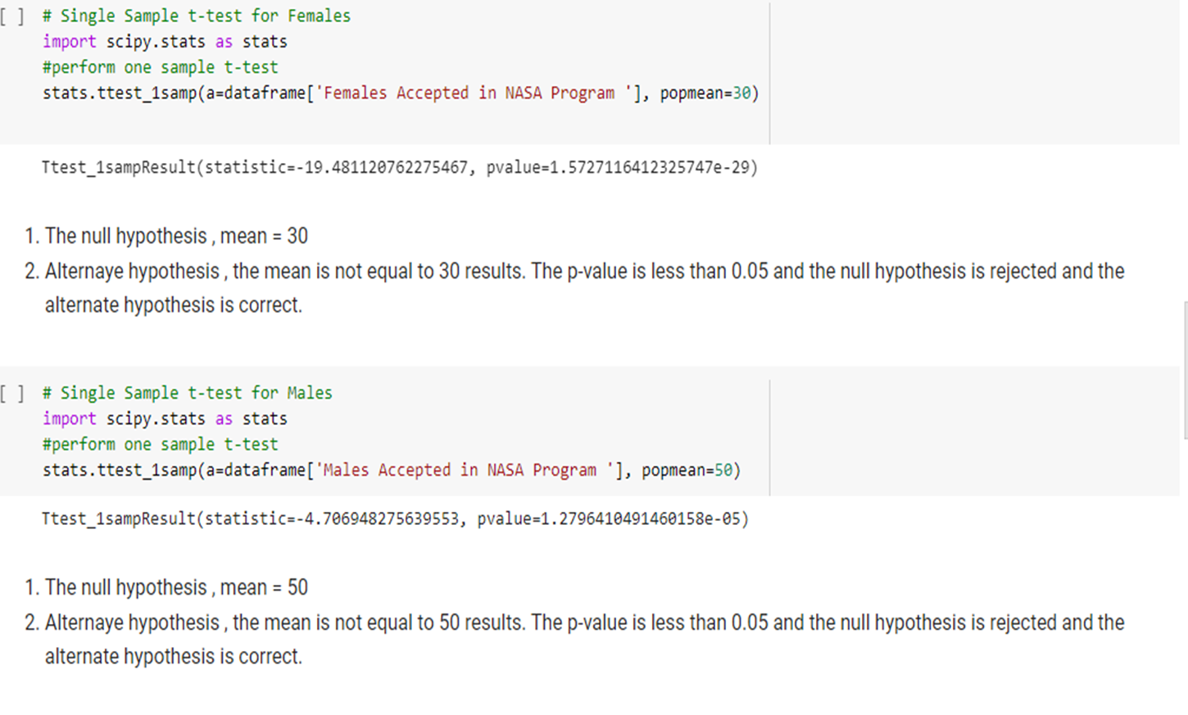
Single Sample T-test for Females vs Male Budget Analysis

Slide 22
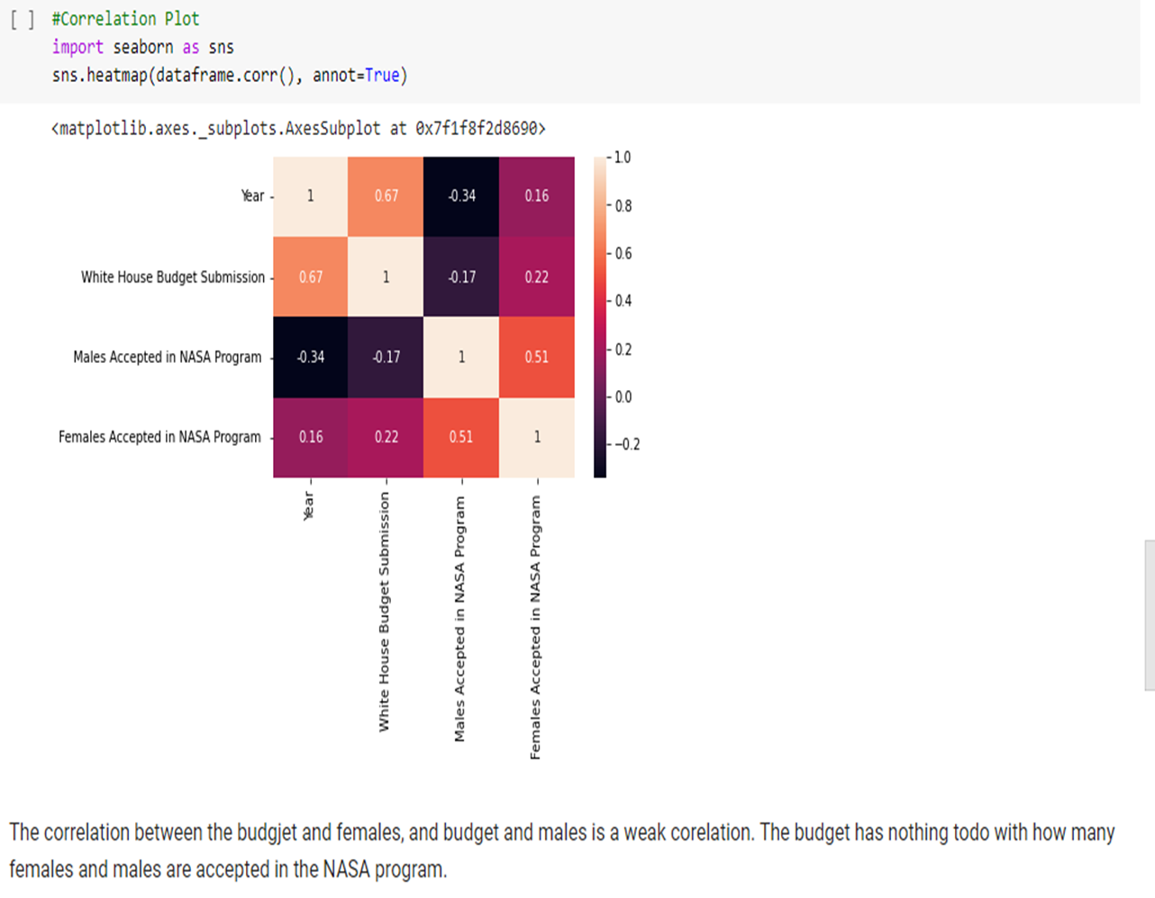
Correlation Plot

Slide 23
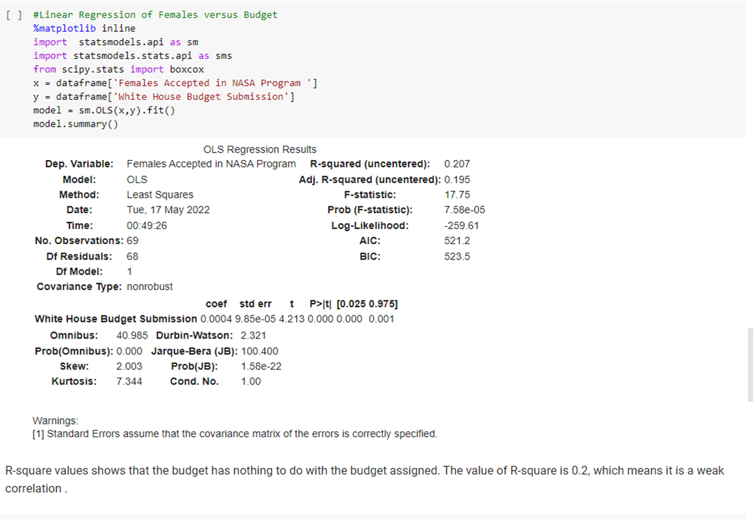
Linear Regression of Females vs. Budget

Slide 24
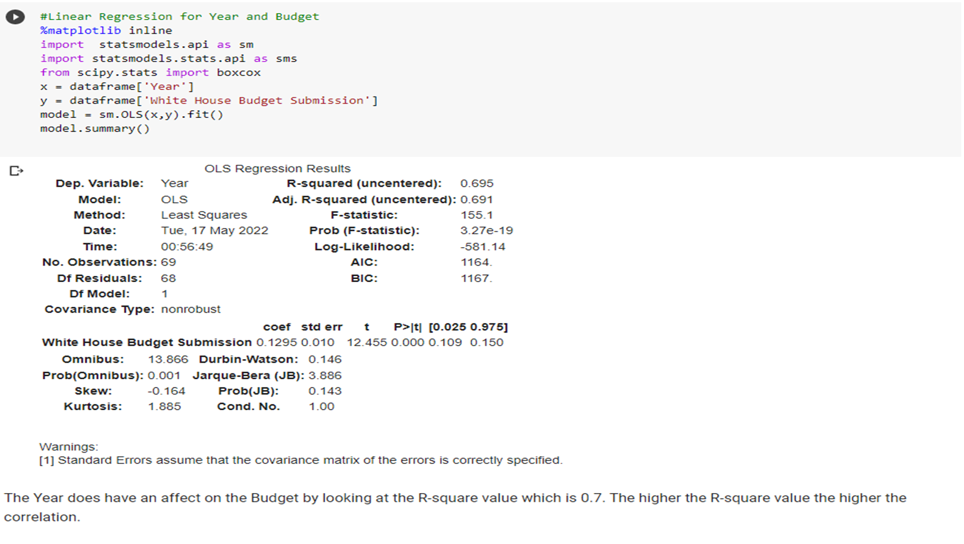
Linear Regression for Year and Budget

Slide 25
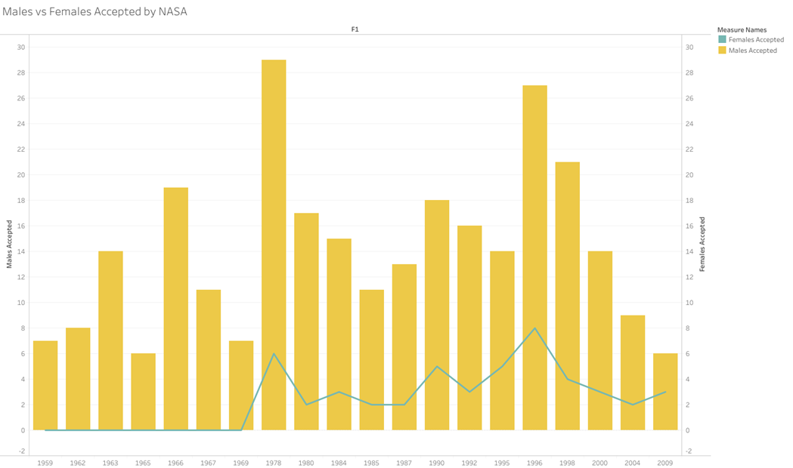
Results: Hiring Rates between Males and Females in NASA
When the NASA program was
first started in 1959, it was only
populated by males who had
military background.
In 1978, the first females
were selected as astronaut
candidates
Every year since 1978, the
intake of females into the
program are always less than
those of males accepted into
the NASA program

Slide 26
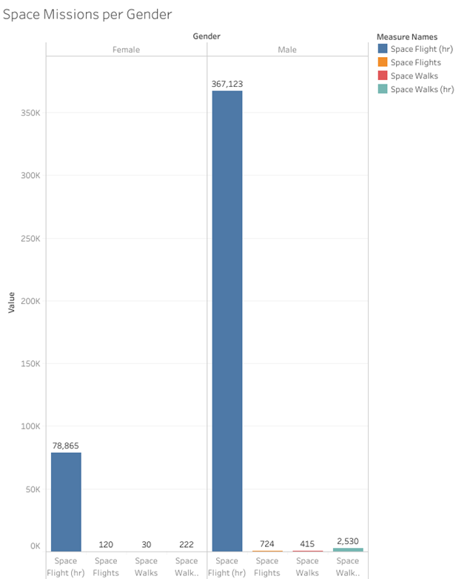
Results: Ratio of males to females that are sent on space missions
Males had a greater number of collective hours on Space flights and Space Walks.
Females had a higher average of individual hours!

Slide 27
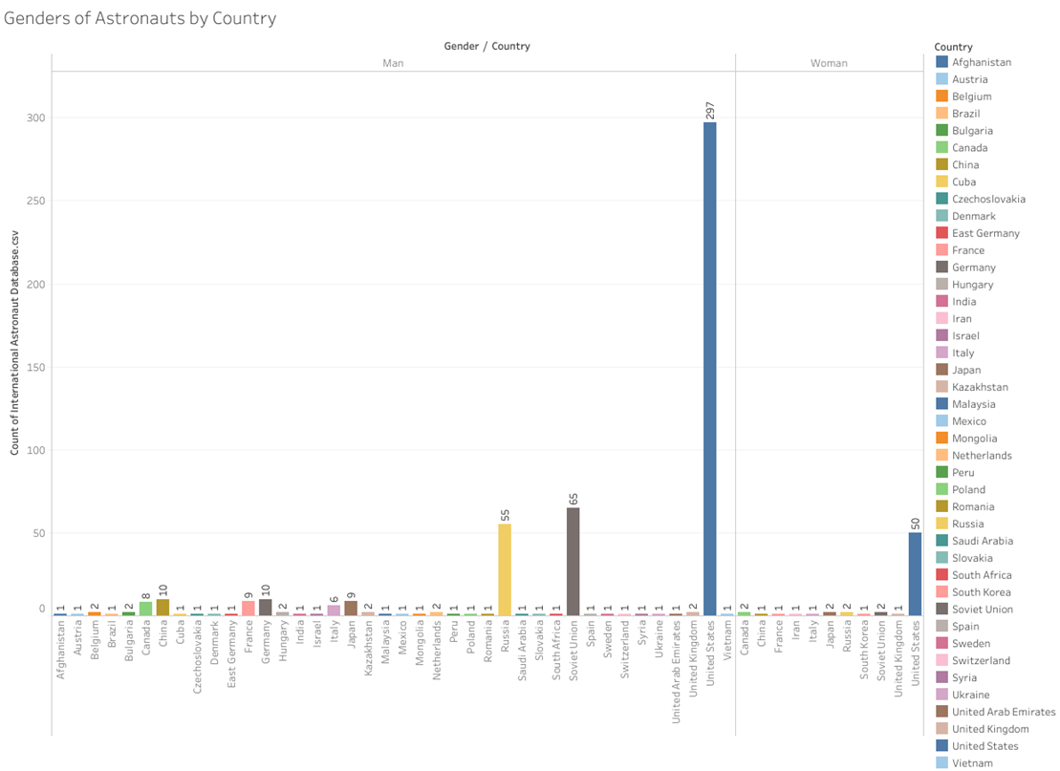
Results: Exploratory Findings
The United States produces the most astronauts
The Soviet Union and Russia produce the second and third highest number of astronauts
Only 9 countries hired both male and female astronauts
2 countries (Iran and South Korea) only have females representing their countries as astronauts

Slide 28
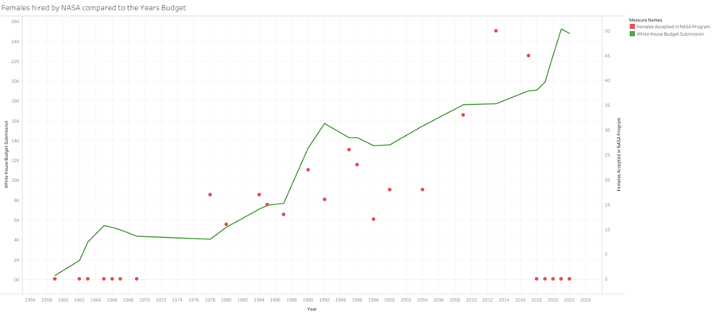
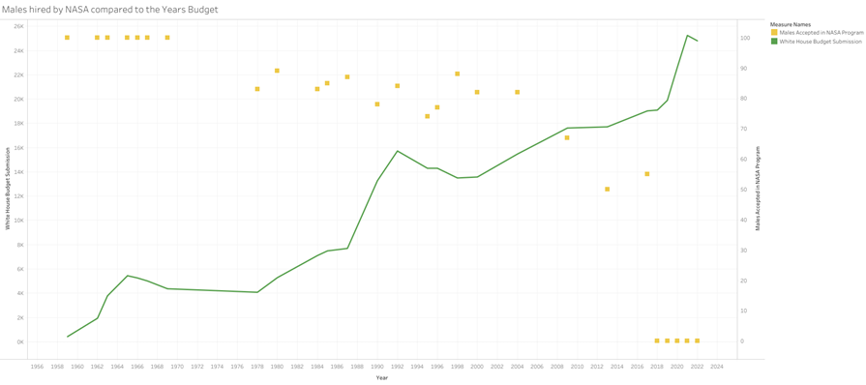
Results: Exploratory Findings
Budget has no influence on the hiring of female astronauts
Budget has no significant influence on the hiring of male astronauts

Slide 29
Summary
The US is the leading country in having astronauts in both men and women
In the US, NASA has only 10% women astronauts In the world women astronauts consist of only 14%
One question that we asked ourselves is “Did the white house budget for the NASA program have an impact on how many women and men were hired into it?”

Slide 30
Conclusion
How did your findings impact the world at large?
What's important about this work?

Slide 31
Questions?

